Slide 1
382N.1: Computer Architecture Fall 2018: Lecture 20
Dam Sunwoo
University of Texas at Austin
Arm Research
(Many slides borrowed from
Prof. Onur Mutlu (ETH Zurich) with permission)

Slide 2
Announcements
Review on Wednesday?

Slide 3
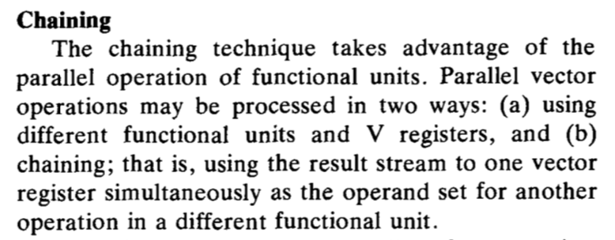
Vector with Chaining Performance, 1 Memory Port
182 cycles
Q about overlapping 11-cycles of V1 Load?
V0 (Load)
V1 (Load)
V2 (Add)
VLN = 50 ; 1
VST = 1 ; 1
V0 = A[0..VLN-1] ; 11 + VLN - 1
V1 = B[0..VLN-1] ; 11 + VLN - 1
V2 = V0 + V1 ; 4 + VLN - 1
V3 = V2 >> 1 ; 1 + VLN - 1
C[VST...VST+VLN-1] = V3 ; 11 + VLN – 1
V3 (Shift)
C (Store)

Slide 4
Assumptions for Cray-1
Cray-1 used SRAM for main memory (~8MB)
Each memory bank has single port
Example with Chaining with 2 load ports and 1 store port
Assumed 2 load ports and 1 store port in each bank

Slide 5
Recap: Banking in Cray-1
Bank
0
Bank
1
Bank
2
Bank
15
MDR
MAR
MDR
MAR
MDR
MAR
MDR
MAR
Data bus
Address bus
CPU

Slide 6
Memory Initiation Rate
Memory speed must keep up with CPU speed!
Interleave memory banks
To maintain initiation rate of 1, the number of banks must be at least the ratio of memory to processor cycle time.
However, if processor make access in non-unit stride, it is possible to have bank conflicts.
# banks >= mem_latency / cycle_time
Cray: 50ns / 12.5ns = 4
Why 16 banks?

Slide 7
Memory Initiation Rate
In general, effective bandwidth (relative to 1 bank) is
Number of banks / GCD(stride, number of banks)
Example: stride = 1, number of banks = 16, 16/1 = 16
Stride = 16, number of banks = 16, EB = 16/16 = 1
Stride = 8, number of banks = 16, 16/8 = 2
Stride = 3, number of banks = 16, 16/1 = 16
A performance-minded programmer will rearrange data to avoid bad strides (by padding etc)
Alternatively, prime number of banks is an hardware solution.
Only have most serious problem when accessing at stride exactly equal to the number of banks
Difficult to implement though.
Must do real divisions instead of shifts

Slide 8
Interleaving
When using multiple banks the address space needs to be partitioned between the banks
Good way of doing it is to interleave banks across the address range
Which address bits should you use to interleave?
Why?

Slide 9
Interleaving: One Uses MSB the other LSB to Interleave (word addressed)
4
0
5
1
6
2
000
0
7
3
001
1
010
2
011
3
100
4
101
5
110
6
111
7
1
0
3
2
5
4
7
6
Any other options? Why one over another?

Slide 10
Multiple Memory Chips
15:1
MAR
0
How are data wires hooked up?
How is address hooked up?
How is CE hooked up?
How is WE hooked up?
Can we build a banked memory system out of this?
What needs to change?
What do we lose?
logic
CE
X8
high
WE
CE
X8
low
WE
8
8
MDR
16
Notes:
10

Slide 11


DRAM Cell
What happens when you read?
11
Notes:
11

Slide 12
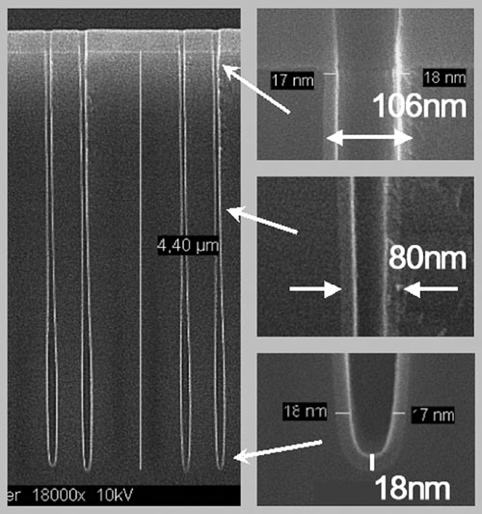
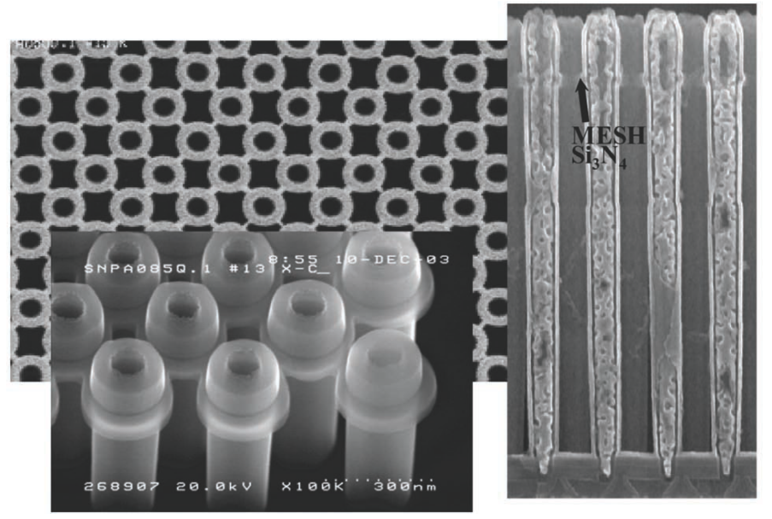
DRAM Cell
What happens when you read?
Infineon 80nm
12
Notes:
12

Slide 13
DRAM Refresh
Capacitor holding value leaks, eventually you will lose information (everything turns to 0)
How do you maintain the values in DRAM?
13
Notes:
13

Slide 14
Simplified DRAM Internal Structure
Row
RAS
Addr
Column
CAS
14
Notes:
14

Slide 15
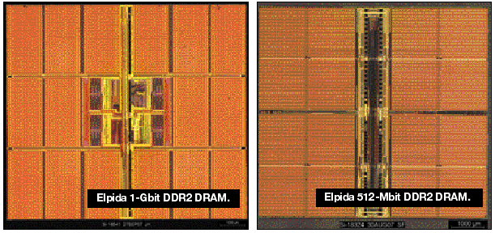
Simplified DRAM Internal Structure
Row
RAS
Column
CAS
Addr
15
Notes:
15

Slide 16
DRAM Chip
Simple diagram to convey meaning
Current interfaces more involved (more on this later)
RAS
CE
CAS
address
WE
n
k
16
Notes:
16

Slide 17
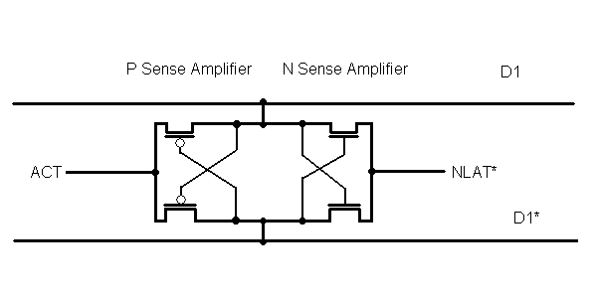
DRAM Sense Amplifier
Initially, ACT at Vss (GND) and NLAT* held at Vcc/2
To read: Wordline pulled to Vcc+Vth, D1/D1* changes
To sense:
First, NLAT* is pulled towards ground
Then ACT is pulled towards Vcc

Slide 18
DRAM Sense Amplifier
VCC
GND
OR
GND
VCC

Slide 19
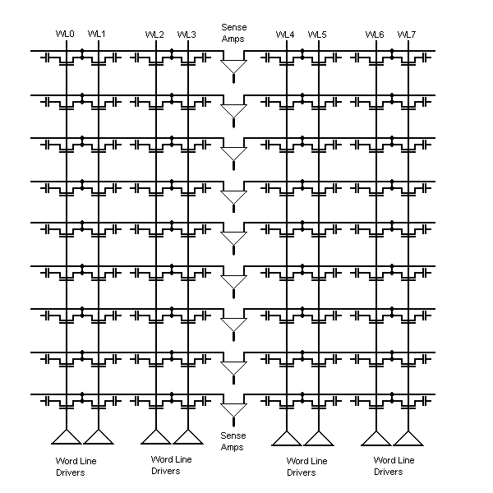
DRAM Array

Slide 20
Accessing DRAM (RAS)
Simplified Bank State Diagram
act
rd
bank 0
DRAM
Memory array
Row decoder
pre
wr
request
Sense amplifier
Operation Resource Utilization
Column decoder
Cycle
Activate
Row
data
Request
Data

Slide 21
Accessing DRAM (CAS)
Simplified Bank State Diagram
act
rd
bank 0
DRAM
Memory array
Row decoder
pre
wr
request
Sense amplifier
Operation Resource Utilization
Column decoder
Cycle
Read
Row
data
Request
Data

Slide 22
Accessing DRAM (re-writing “lost” data)
Simplified Bank State Diagram
act
rd
bank 0
DRAM
Memory array
Row decoder
pre
wr
request
Sense amplifier
Operation Resource Utilization
Column decoder
Cycle
Precharge
Row
data
Request
Data

Slide 23
DRAM RAS/CAS Summary
Assert RAS to specify row address
Assert CAS to specify column address
Why separate RAS/CAS?
Can pulse CAS to read more from the same row
Faster
Implications?
Called Fast Page Mode
23
Notes:
23

Slide 24
What to do while waiting for Act/Pre/…?
bank 1
bank 0
bank n-1
DRAM
Memory array
Row decoder
request
Sense amplifier
Column decoder
data

Slide 25
DRAM Hierarchy/Banks
Row
RAS
Column
CAS
Bank[1:0]
Why have banks?
Cannot access banks back-to-back. Why?
Notes:
25

Slide 26
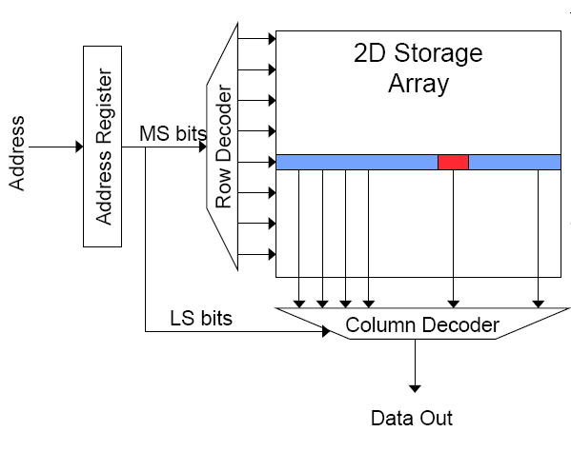
Memory Bank Organization and Operation
Read access sequence:
1. Decode row address & drive word-lines
2. Selected bits drive bit-lines
• Entire row read
3. Amplify row data
4. Decode column address & select subset of row
• Send to output
5. Precharge bit-lines
• For next access

Slide 27
Page Mode DRAM
A DRAM bank is a 2D array of cells: rows x columns
A “DRAM row” is also called a “DRAM page”
“Sense amplifiers” also called “row buffer”
Each address is a <row,column> pair
Access to a “closed row”
Activate command opens row (placed into row buffer)
Read/write command reads/writes column in the row buffer
Precharge command closes the row and prepares the bank for next access
Access to an “open row”
No need for activate command

Slide 28
DRAM Bank Operation
Access Address:
(Row 0, Column 0)
Columns
(Row 0, Column 1)
(Row 0, Column 85)
(Row 1, Column 0)
Row address 0
Row address 1
Row decoder
Rows
Row Buffer
CONFLICT !
HIT
Row 1
HIT
Row 0
Empty
Column address 0
Column mux
Column address 0
Column address 1
Column address 85
Data

Slide 29
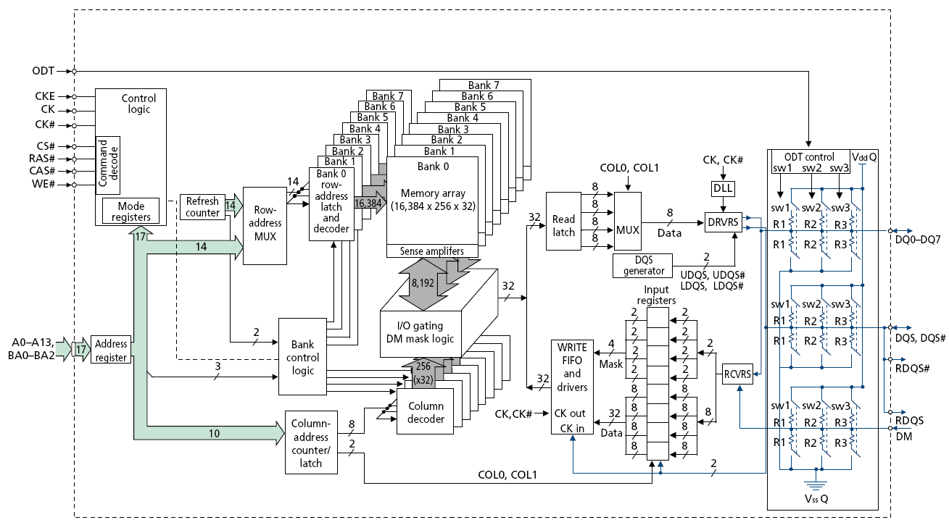
128M x 8-bit DRAM Chip

Slide 30
DRAM Rank and Module
Rank: Multiple chips operated together to form a wide interface
All chips comprising a rank are controlled at the same time
Respond to a single command
Share address and command buses, but provide different data
A DRAM module consists of one or more ranks
E.g., DIMM (dual inline memory module)
This is what you plug into your motherboard
If we have chips with 8-bit interface, to read 8 bytes in a single access, use 8 chips in a DIMM

Slide 31
A 64-bit Wide DIMM (One Rank)

Slide 32
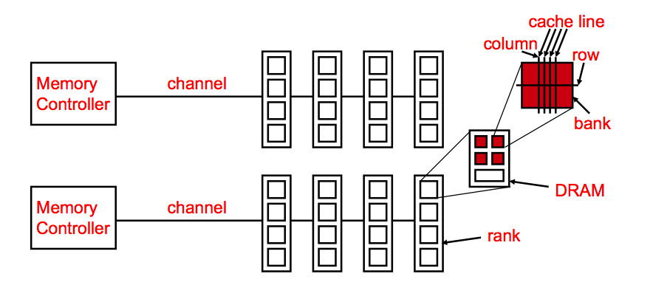
Generalized Memory Structure

Slide 33
DRAM Subsystem Organization
Channel
DIMM
Rank
Chip
Bank
Row/Column

Slide 34
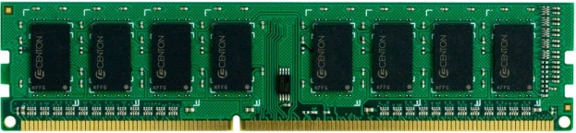
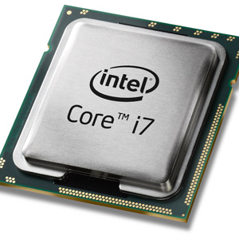
The DRAM subsystem
“Channel”
DIMM (Dual in-line memory module)
Processor
Memory channel
Memory channel

Slide 35
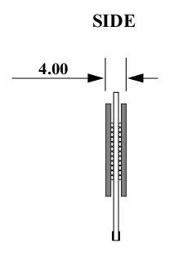
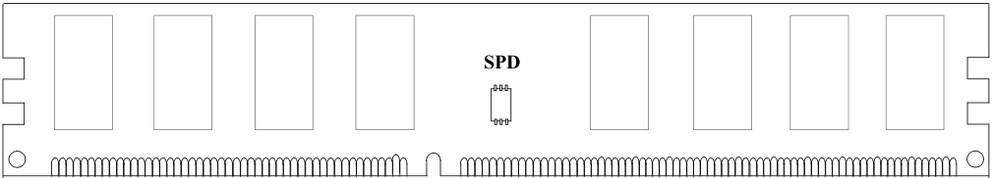
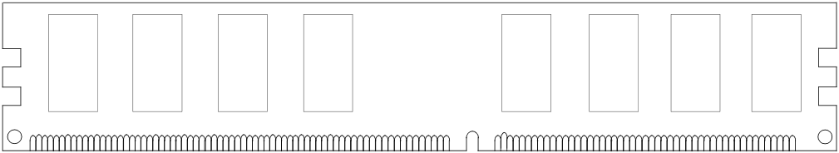
Breaking down a DIMM
DIMM (Dual in-line memory module)
Side view
Front of DIMM
Back of DIMM
SPD (Serial Presence Detect):
Let system know what memory is present and what timings to use

Slide 36
Breaking down a DIMM
DIMM (Dual in-line memory module)
Side view
Front of DIMM
Back of DIMM
Rank 0: collection of 8 chips
Rank 1

Slide 37
Rank
Rank 0 (Front)
Rank 1 (Back)
<0:63>
<0:63>
Addr/Cmd
CS <0:1>
Data <0:63>
Memory channel

Slide 38
Breaking down a Rank
. . .
Chip 0
Chip 1
Chip 7
Rank 0
<0:63>
<0:7>
<8:15>
<56:63>
Data <0:63>

Slide 39
Breaking down a Chip
8 banks
Chip 0
Bank 0
<0:7>
<0:7>
<0:7>
...
<0:7>
<0:7>

Slide 40
Breaking down a Bank
2kB
1B (column)
row 16k-1
Bank 0
...
row 0
<0:7>
Row-buffer
1B
1B
1B
...
<0:7>

Slide 41
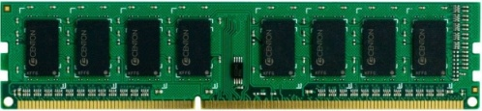


Example: Transferring a cache block
Physical memory space
0xFFFF…F
Channel 0
...
DIMM 0
Mapped to
0x40
Rank 0
64B
cache block
0x00

Slide 42
Example: Transferring a cache block
Physical memory space
Chip 0
Chip 1
Rank 0
Chip 7
0xFFFF…F
. . .
...
<0:7>
<8:15>
<56:63>
0x40
64B
cache block
Data <0:63>
0x00

Slide 43
Example: Transferring a cache block
Physical memory space
Chip 0
Chip 1
Rank 0
Chip 7
0xFFFF…F
. . .
Row 0
Col 0
...
<0:7>
<8:15>
<56:63>
0x40
64B
cache block
Data <0:63>
0x00

Slide 44
Example: Transferring a cache block
Physical memory space
Chip 0
Chip 1
Rank 0
Chip 7
0xFFFF…F
. . .
Row 0
Col 0
...
<0:7>
<8:15>
<56:63>
0x40
64B
cache block
Data <0:63>
8B
0x00
8B

Slide 45
Example: Transferring a cache block
Physical memory space
Chip 0
Chip 1
Rank 0
Chip 7
0xFFFF…F
. . .
Row 0
Col 1
...
<0:7>
<8:15>
<56:63>
0x40
64B
cache block
Data <0:63>
8B
0x00

Slide 46
Example: Transferring a cache block
Physical memory space
Chip 0
Chip 1
Rank 0
Chip 7
0xFFFF…F
. . .
Row 0
Col 1
...
<0:7>
<8:15>
<56:63>
0x40
8B
64B
cache block
Data <0:63>
8B
0x00
8B

Slide 47
Example: Transferring a cache block
Physical memory space
Chip 0
Chip 1
Rank 0
Chip 7
0xFFFF…F
. . .
Row 0
Col 1
...
<0:7>
<8:15>
<56:63>
0x40
8B
64B
cache block
Data <0:63>
8B
0x00
A 64B cache block takes 8 I/O cycles to transfer.
During the process, 8 columns are read sequentially.

Slide 48
Latency Components: Basic DRAM Operation
CPU → controller transfer time
Controller latency
Queuing & scheduling delay at the controller
Access converted to basic commands
Controller → DRAM transfer time
DRAM bank latency
Simple CAS (column address strobe) if row is “open” OR
RAS (row address strobe) + CAS if array precharged OR
PRE + RAS + CAS (worst case)
DRAM → Controller transfer time
Bus latency (BL)
Controller to CPU transfer time

Slide 49
Multiple Banks (Interleaving) and Channels
Multiple banks
Enable concurrent DRAM accesses
Bits in address determine which bank an address resides in
Multiple independent channels serve the same purpose
But they are even better because they have separate data buses
Increased bus bandwidth
Enabling more concurrency requires reducing
Bank conflicts
Channel conflicts
How to select/randomize bank/channel indices in address?
Lower order bits have more entropy
Randomizing hash functions (XOR of different address bits)

Slide 50
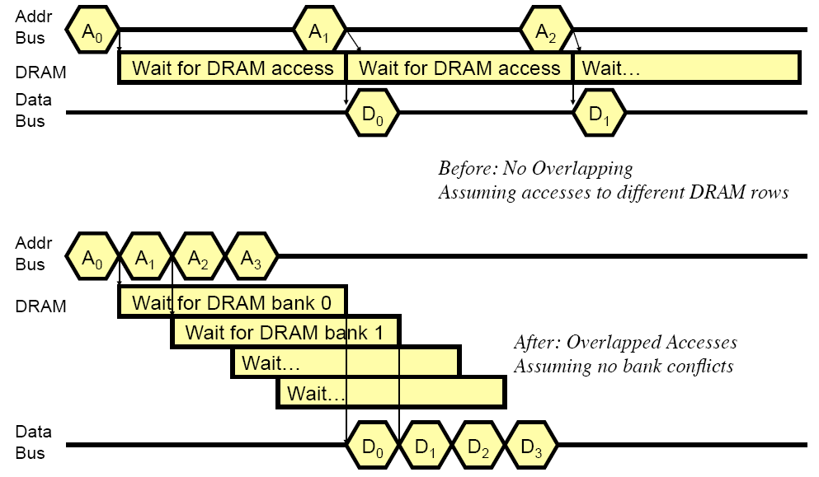
How Multiple Banks Help

Slide 51
Even more memory
Memory channels
Separate buses
Kind of like Cray 1 banks
So now a deep hierarchy
Channels
Ranks
Banks
Rows
Columns
Bits
All of these some sort of “bank”
DRAM bank is internal
Ranks and channels external
Not quite pure random access

Slide 52
Specifying a DRAM address
Channel
Rank
Bank
Row
Col
Granularity:
Each chip address holds (width) bits
So overall granularity is chips*width (rank width)
But, burst mode so actual memory transfer block is bigger
How to interleave?

Slide 53
Interleaving revisited
Bank conflicts
Row-buffer (DRAM page) locality
Channel balance
Ranks?
Access pattern impact?
0, 1, 2, 3, 4, …
0, 64, 128, …
0, 7, 2, 9, 11, 15, 12, …

Slide 54
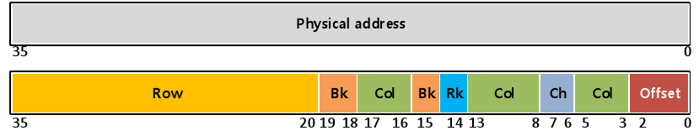
Interleaving revisited (solutions)
Bank conflicts
Row-buffer (DRAM page) locality
Channel balance
Bit swizzling
Example: Intel Nehalem (first Intel Core i7)
More sophisticated hashing
Later Intel processors

Slide 55
Address Mapping (Single Channel)
Single-channel system with 8-byte memory bus
2GB memory, 8 banks, 16K rows & 2K columns per bank
Row interleaving
Consecutive rows of memory in consecutive banks
Accesses to consecutive cache blocks serviced in a pipelined manner
Cache block interleaving
Consecutive cache block addresses in consecutive banks
64 byte cache blocks
Accesses to consecutive cache blocks can be serviced in parallel
Row (14 bits)
Bank (3 bits)
Column (11 bits)
Byte in bus (3 bits)
Row (14 bits)
High Column
Bank (3 bits)
Low Col.
Byte in bus (3 bits)
8 bits
3 bits

Slide 56
Bank Mapping Randomization
DRAM controller can randomize the address mapping to banks so that bank conflicts are less likely
Reading:
Rau, “Pseudo-randomly Interleaved Memory,” ISCA 1991.
3 bits
Column (11 bits)
Byte in bus (3 bits)
XOR
Bank index (3 bits)

Slide 57
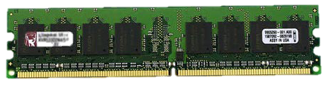
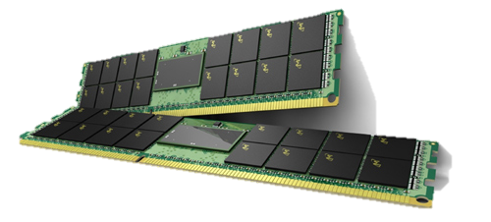
Memory Modules (DIMMs)
Dual In-line Memory Module (DIMM)
Standard memory interface today
Multiple chips on independent module
Easy to build and maintain systems
DIMMs have one or more “ranks”
Rank is multiple chips that share same CE
MAR
1
0
logic
Width?
Ranks?
Chips/rank?
CE
x8
WE
CE
x8
WE
CE
x8
WE
CE
x8
WE
addr
8
8
8
8

Slide 58
Even More Memory
MAR
1
0
logic
CE
x8
WE
CE
x8
WE
CE
x8
WE
CE
x8
WE
addr
8
8
8
8
Notes:
58

Slide 59
Comparison Between Cray 1 and Modern DRAM
Cray 1 used simple memory arrays (not DRAM at the time)
Each array could process one request at a time
Each request took 4 CPU cycles (50ns)
Used 16 banks to allow multiple outstanding requests and pipelining to keep the data bus busy
Modern DRAM chip internally has multiple banks (typically 8)
Each bank has multiple arrays but all accessed together
Each array accesses takes several DRAM cycles
Banking works to keep DRAM chip data bus busy
Multiple ranks
Multiple ranks are a way of adding capacity without changing the bus width or using narrower chips
Can be thought of as adding more banks (multiply number of internal banks by number of ranks)

Slide 60
Improving Memory Throughput/Bandwidth using Interleaving/Banking
Latency
How long does it take to get from here to there
and, maybe, back again
Throughput/Bandwidth
How many things can be done in some unit of time
Memory has long latency and relatively throughput
Early memory accesses could not be pipelined
when servicing one operation, others must wait
How can throughput be increased?
Interleaving/Banking
Longer bursts – get more for each DRAM access
RDRAM original approach
RDRAM was not successful because of business issues and late supply, not the technology

Slide 61
Even Higher Bandwidth (multiple channels)
What can we do if we want even higher bandwidth?
Bus already utilized
Add more bus bandwidth
Increase width or increase frequency
Frequency already very high and accesses are wide
Now at least 64B per access (512 bits)
Add more buses
Each bus controlled separately and connects to multiple DRAM chips/ranks
Each bus+controller called a channel

Slide 62
Memory Interfaces
How much data per column command?
Interface width (x4, x8, …)
How much data per bus transfer
Note: each column DRAM address refers to width bits
Burst length (4, 8, …)
How many bus transfers per CAS
DDRx
Double-data rate – multiple data transfers per clock (rising and falling edge, or even faster)
DDR, then DDR2, then DDR3 – just different standards for defining sizing, timing, and electrical parameters

Slide 63
What Memory Should I Use?
Depends on access characteristics
How often is it written?
How often is it accessed in general?
How fast should the accesses be?
Latency? Bandwidth?
What should the capacity be?
Bytes? Kilobytes? Megabytes? Gigabytes? Terbytes?
How long should the data last?
Microseconds? Seconds? Years? Decades?
Granularity of access
Cost
Dollars, watts or joules, …
Different memories optimized for different access types
SRAM, DRAM, FLASH, STT-RAM, Phase Change, magnetic disk…

Slide 64
Memory
Cheap
Efficient
Dense (high capacity)
Fast
Reliable
Notes:
30

Slide 65
Latency impacted by cell access
denser/efficient → higher latency/lower BW
Small cells → sensitive circuits → slow reads
Writes even more complicated
High BW needs more vias / wires/ circuits
+ latency
+ BW
– density
– cost – energy
– latency
– BW
+ density
+ cost + energy

Slide 66
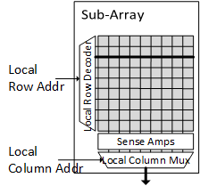
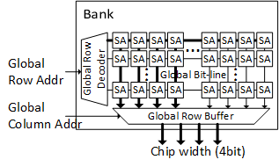
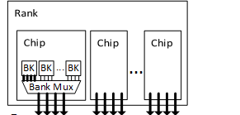
Memory system
Modules, packages, components
Arranged in a hierarchy
Each memory component
Has hierarchy
Has caching/buffering

Slide 67
Latency + throughput + efficiency → parallelism

Slide 68
Latency + throughput + efficiency → parallelism
Access cell

Slide 69
Latency + throughput + efficiency → parallelism
Many pins in parallel
Access many cells in parallel

Slide 70
Latency + throughput + efficiency → parallelism
Many pins in parallel over multiple cycles
Access even more cells in parallel

Slide 71
Latency + throughput + efficiency → parallelism
Many pins in parallel over multiple cycles
Access even more cells in parallel

Slide 72
Hierarchy + parallelism → potential waste

